Slide 1
Software-ontwerp
Presentatie: Iteratie 2
Karina Karapetyan
Laurens Cleemput
Tom Houben
Tri Tran

Slide 2
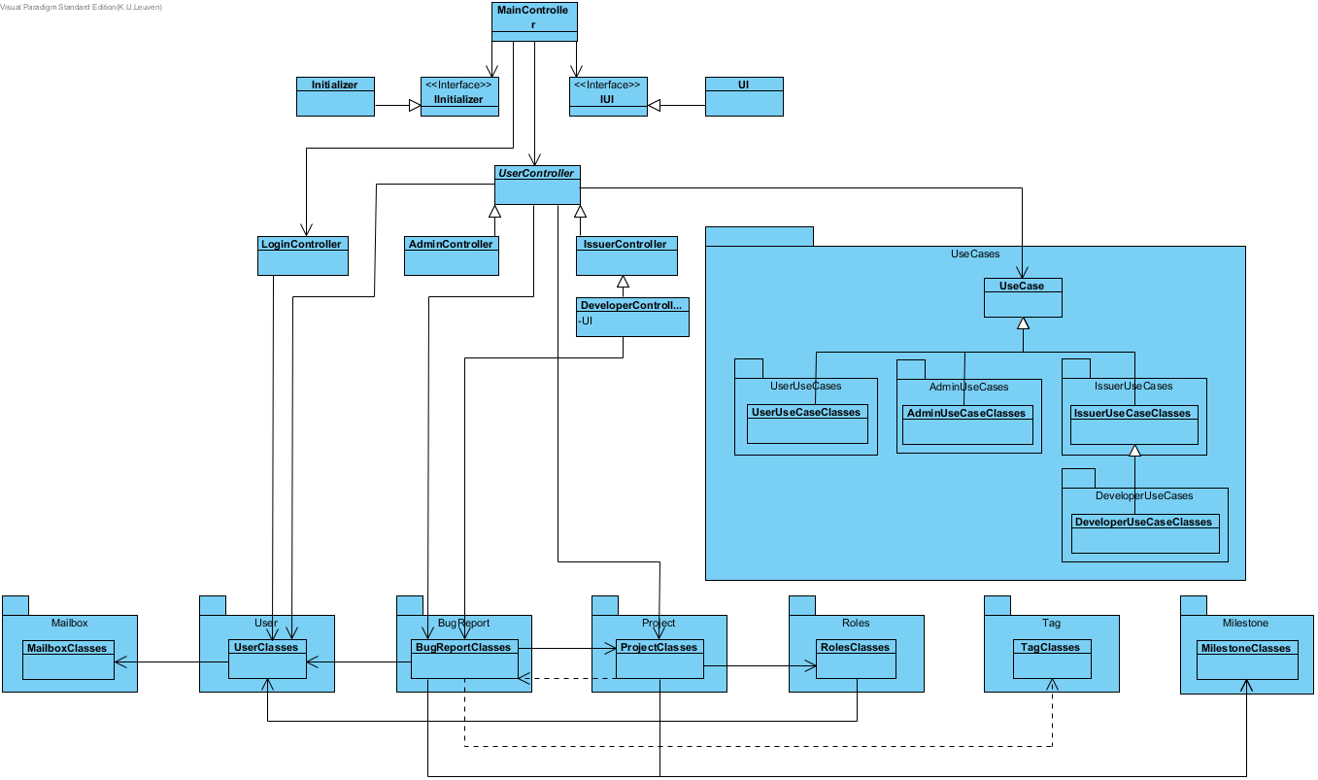
High Level Design

Slide 3
High Level Design
Each use case in separate class, grouped by user type
Extensions in domain layer: Mailbox, Milestone
New classes added in similiar fashion to iteration 1

Slide 4
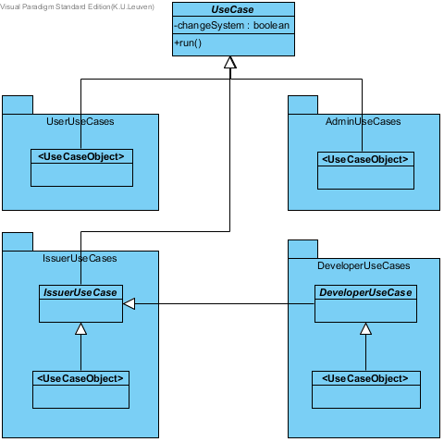
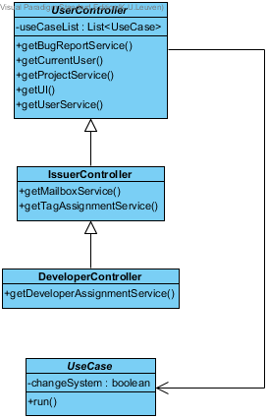
Use Cases

Slide 5
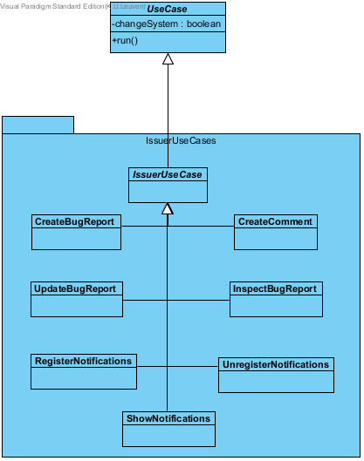
Use Cases: Example

Slide 6
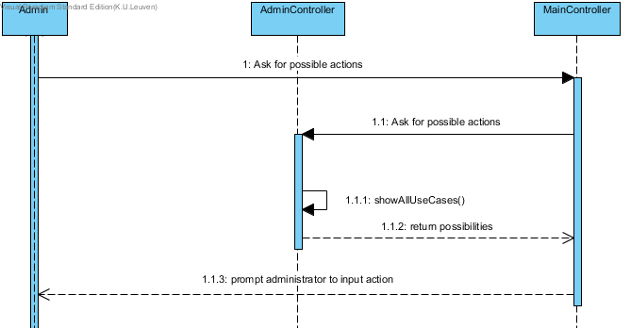
Use Cases: Example

Slide 7
State Pattern
Tags are STATES
The behaviour of a bugreport depends on the tag assigned to it

Slide 8
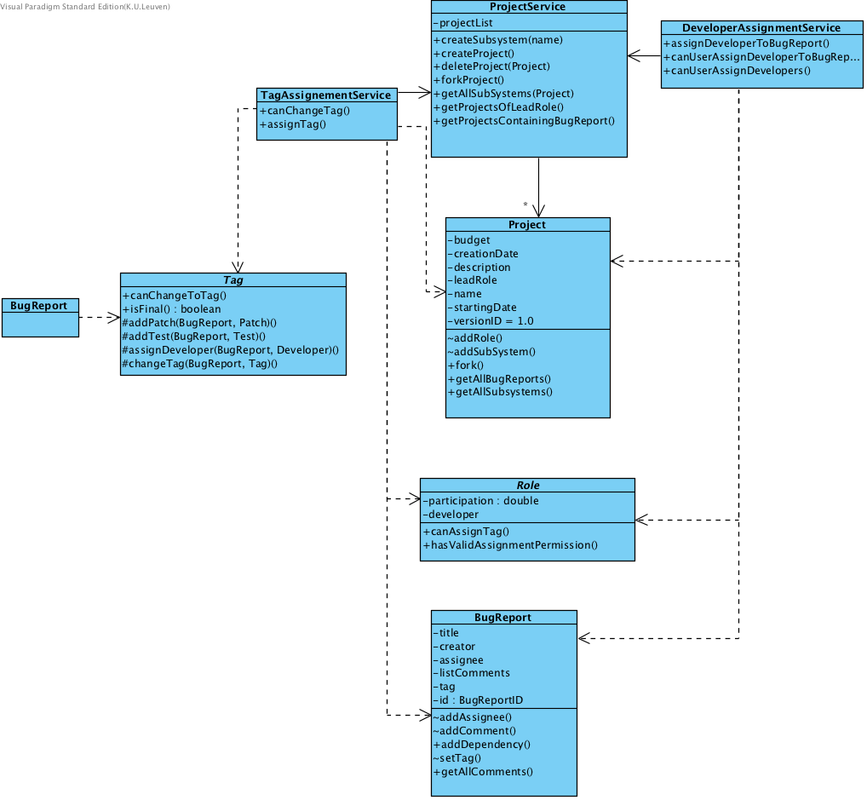
Usage of the domain layer

Slide 9
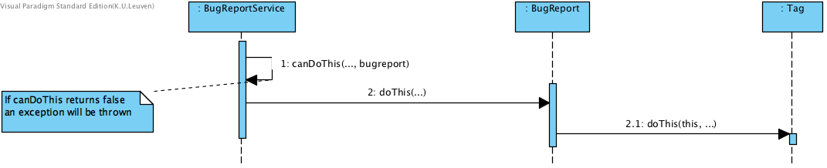
State pattern: Abstract
BugReport calls Tag to execute the function

Slide 10
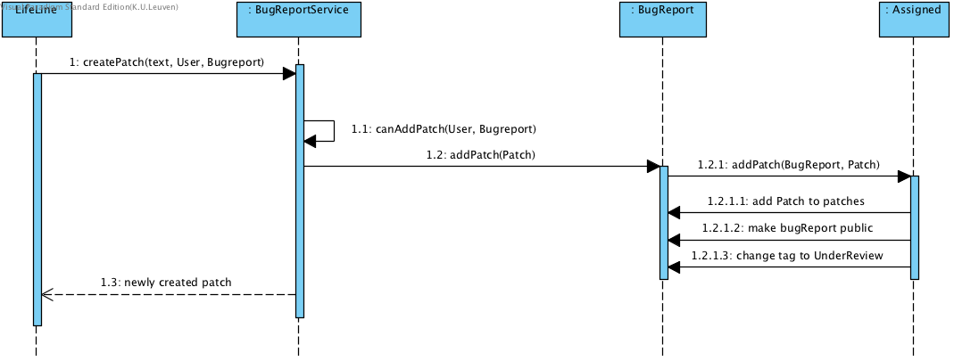
State pattern: Concrete Example
“When a bug report is created, it can be marked as private. […] Once the first patch is submitted for the bug report, it is visible for all the users of BugTrap.”
“[…] after the first patch, the tag of the bug report at stake transitions from Assigned to UnderReview.”
:User

Slide 11
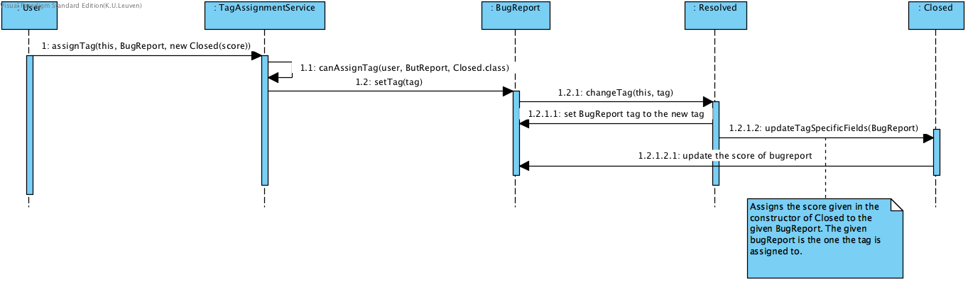
Tag specific infromation
“As a final step, the creator of a resolved bug report can close it (i.e. assign the tag Closed) by specifying how satisfied he is with the solution.”

Slide 12
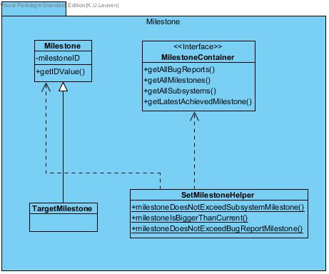
Milestones
Milestone = separate object Assigned to a project, subsystem or bug report (Target milestone)
Separate class for target milestone → optional, always initialized with a specific milestone (≠ “M0”)
Container → needed for checkers
Helper → provides checkers for milestone

Slide 13
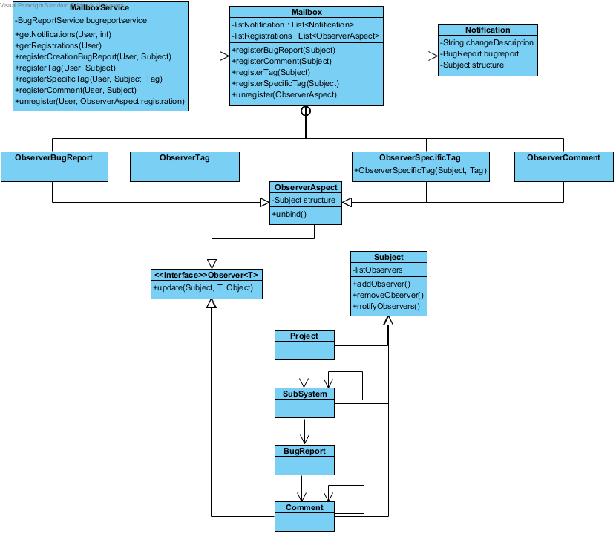
Mailbox System

Slide 14
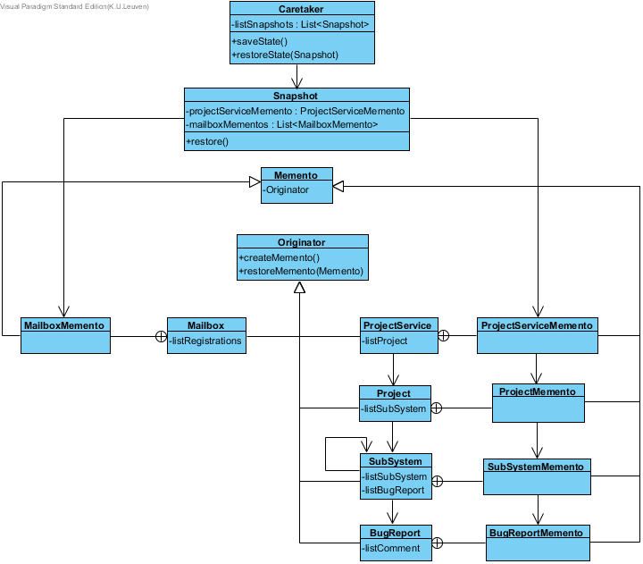
Undo mechanism

Slide 15
Extensibility of the system:
Adding use cases
UI is still completely independent
Interface for the Initializer
Adding constraints concerning tag
Adding new registration types (for mailboxes) = adding new observers
Search methods for bug reports
Adding new objects that could be undone
Little changes were needed to implement iteration 2 -> great extensibility of our code from iteration 1

Slide 16
Possible improvements
Mailbox creates Observers, could be a task of the MailboxService
Milestone: improvements in the code and structure

Slide 17
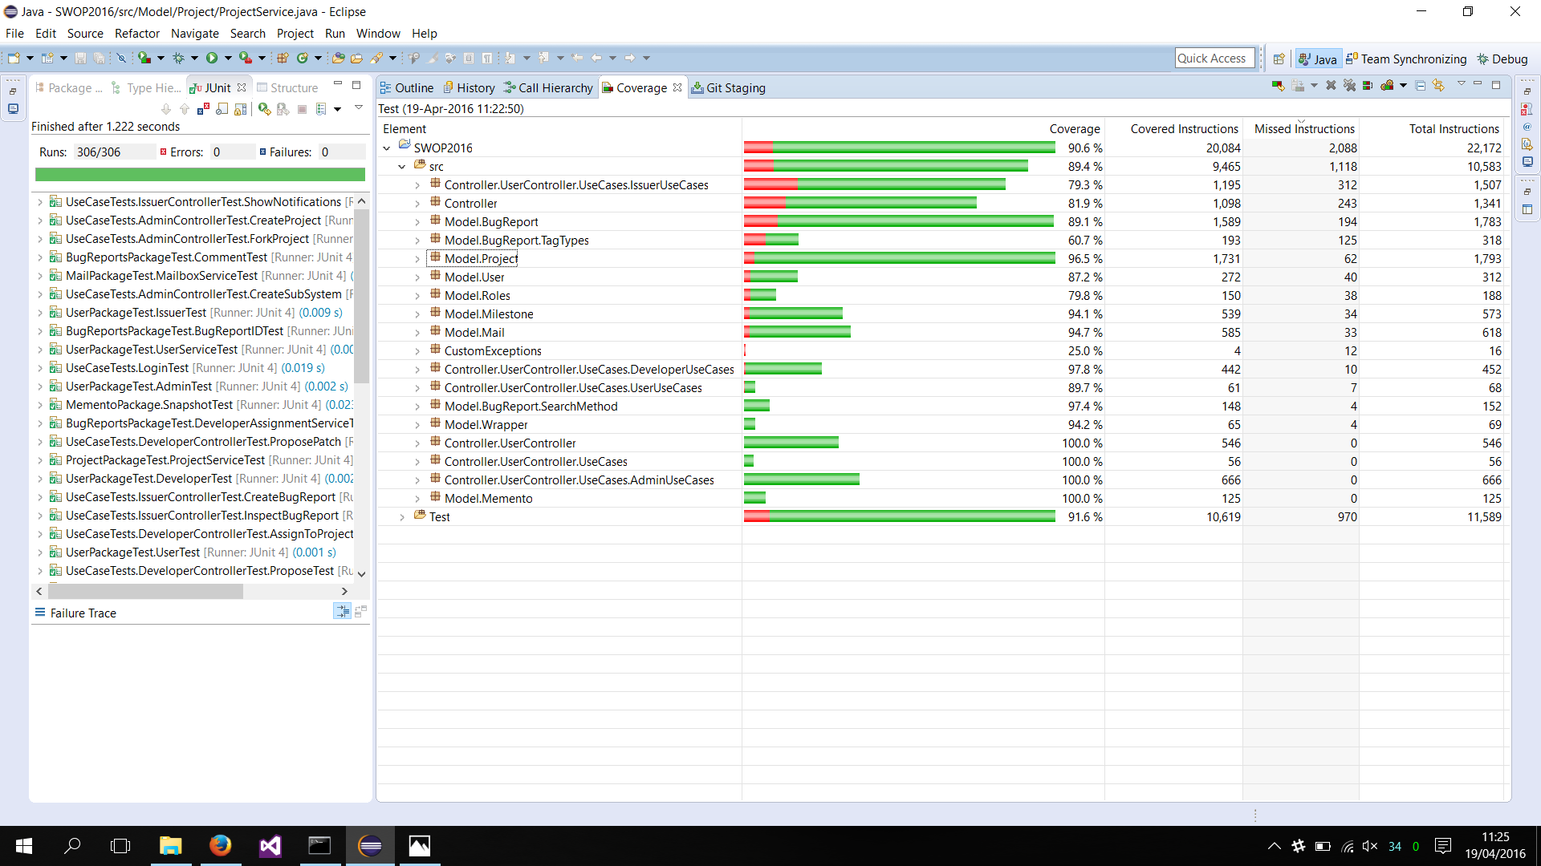
Testing approach

Slide 18

Vragen?

Slide 20
Project Management
Karina Karapetyan
Group work: 31h Individual Work: 20h Study: 7h
Laurens Cleemput
Group work: 31h Individual Work: 23h Study: 6h
Tom Houben
Group work: 31h Individual Work: 15h Study: 4h
Tri Tran
Group work: 31h Individual Work: 51h Study: 14h

Slide 21
Roles
 | Iteratie 1 | Iteratie 2 | Iteratie 3
Design Coordinator | Karina Karapetyan Laurens Cleemput | Tom Houben Karina Karapetyan | Tri Tran Tom Houben
Testing Coordinator | Tri Tran | Laurens Cleemput | Karina Karapetyan
Domain Coordinator | Tom Houben | Tri Tran | Laurens Cleemput

